Slide 1
ChoreDash: The Odd Job Finder
Team Members:
Kevin Ajili
Mike Hamilton
Vikram Melkote
Grant Lin
Jimmy (Duy) Nguyen

Slide 2
Our goal...
To create a platform for freelance students to find or post odd jobs around campus.
High level goals
Website with user accounts to post chores / jobs
Allow users who need to find jobs to connect with the job poster
Location service to show distance to jobs and limit job opportunities by radius

Slide 3
Sprint 1 User Stories
Story Points
-As a developer, I want to better understand the MEAN Stack
-As a developer, I want to be comfortable using Git, HTML/CSS, JavaScript
-As a developer, I want an encrypted login system
-As a user, I want a usable web page with member login
-As a developer, I want to restrict users to UCSC emails
5
3
5
8
3

Slide 4
Sprint 2 User Stories
Story Points
-As a user, I want to be able to make a profile page
-As a user, I want to be able to post and manage a job
-As a developer, I want to implement a database that manages posts
-As a user, I want to be able to contact other users by email
3
5
5
1

Slide 5
Sprint 3 User Stories
Story Points
-As a user, I want to be able to respond to job posts
-As a user, I want a user friendly dashboard / user interface
-As a user, I want to see where the jobs are located
-As a user, I want to be able to rate the people I hire
8
5
5
3

Slide 6
Sprint 4 User Stories
Story Points
-As a developer, I want to fully test and debug the website
-As a user, I want to see a visually appealing webpage
-As a user, I want to be able to message/chat with relevant users
-As a user, I want directions to the job
-As a user, I want reminders for upcoming jobs
8
5
3
5
3

Slide 7
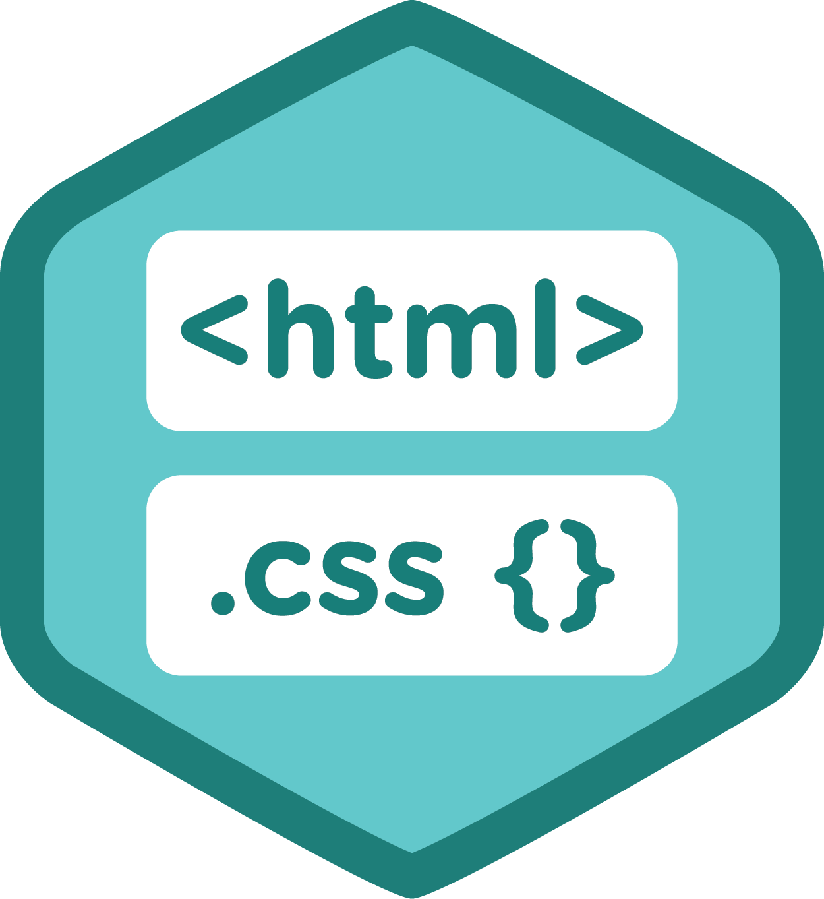




Structure

Slide 8
Challenges/Risks
Challenges:
Learning to work with unfamiliar technologies
Implementing Google Maps API
Time/group management
Risks:
Underestimating timeframe to complete everything

Slide 9
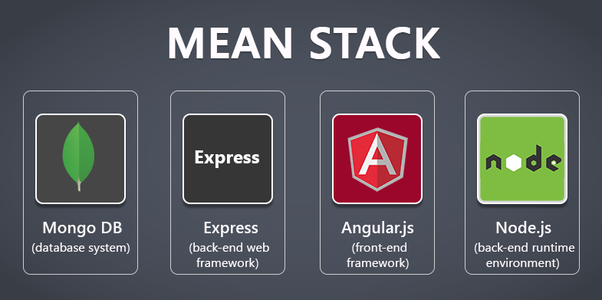
Technologies
Languages:
JavaScript
HTML/CSS
API: Google Maps
Scrum board: Trello
Version control: GitHub

